Slide 1
Redefining Student and Academic Success: Coaching Models at National Louis University and College of Lake County
Mariana Saucedo, National Louis University
Lady Gil, National Louis University
Eric Tammes, College of Lake County

Slide 2
Session Overview
Introductions
Coaching for Academic Success at CLC
Pathways at NLU, new UGC model
Questions

Slide 3
Coaching for Academic Success (CAS)
Coaching for Academic Success intervenes to help students maximize their potential, collaborates with faculty and staff to develop solutions, and engages students with college resources and programs.
Academic coaches inspire students to achieve course success and persistence through effective communication, critical reflection, self-advocacy and resiliency.

Slide 4
CAS Timeline
AQIP Student Success Project: Phase I (spring 2013)
Identified need to support students at-risk
Piloted academic coaching for select sections of developmental math
AQIP Student Success Project: Phase II (fall 2013/spring 2014)
Expanded coaching pilot into developmental English
Refined and assessed program; determined full-time coaches needed
Student Success Fee Increase Approved (spring 2014)
Added $2.50/credit fee to support success initiatives ($4.50 total fee)
Creation of Academic Success Department (summer 2014)
Hired dean, manager and coaches
Launch of Coaching for Academic Success (fall 2014)
Coaches assigned to all developmental math and English courses
Realignment of Academic Success (summer 2016)
TRIO-SSS, Promise Program & One Million Degrees added to department

Slide 5
CAS Department Structure
Director, Academic Success
Academic Success Coaches (5)
Dean, Library, Testing and Academic Success
Manager, TRIO Student Support Services
Program Specialists (2) & Office Manager
Tutoring Coordinators (4)
Tutoring Specialists (2)

Slide 6
CAS Student Support
Follow up on early alerts
Identify issues and solutions
Set measurable and reasonable goals
Develop time management strategies
Deepen connections to faculty, staff and peers
Strengthen communication skills
Connect students to CLC offices and resources
Assist students in assessing academic performance
Motivate students and build confidence
Celebrate successes

Slide 7
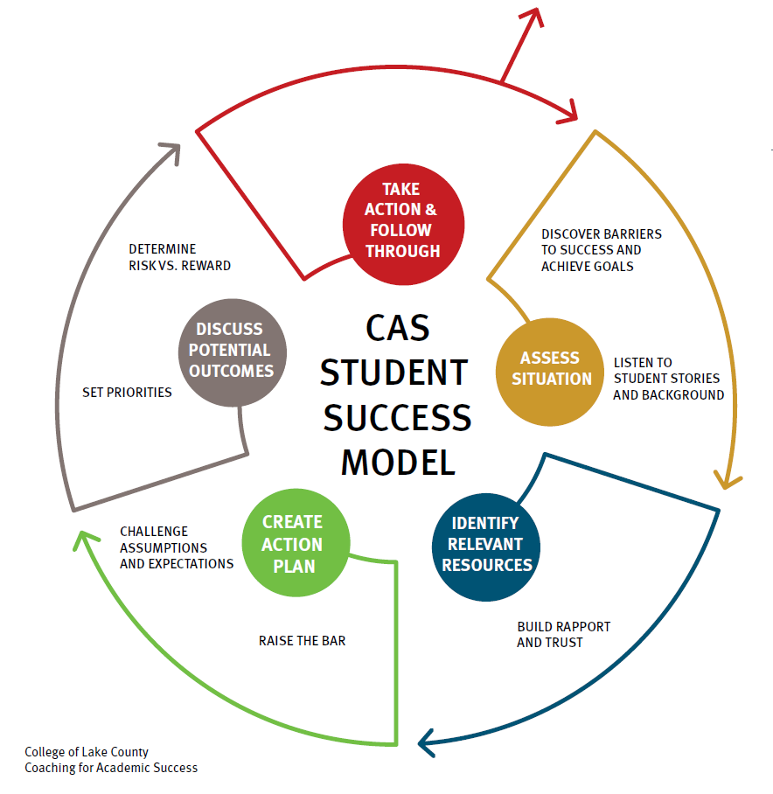

Slide 8
Enhance & Amplify, Not Replace
Academic Coaching
Counseling
Academic Advising
Financial Aid
Disability Services
Veterans Services
Student Activities
Athletics
Multicultural Center
Tutoring
Faculty
International Education
Women’s Center

Slide 9
CAS Program Scope
82 Math
24 English
1,765 Math
312 English
105 Classes
2,077 Students
Students
3229
Coaches are assigned to faculty so there is a primary point of contact

Slide 10
CAS Coaching Structure
Active caseload
Faculty-referred/early alert & self-referred
Assigned caseload
All students in dev ed
Faculty-referred
50-75% of active caseload
Self-referred
25-50% of active caseload
Active caseload: faculty-referred/early alert & self-referred
Assigned caseload:
All students in dev ed
Faculty-referrals/alerts (50-75% of active caseload)
Self-referrals (25-50% of active caseload)

Slide 11
CAS Course Outcomes: English

Slide 12
CAS Course Outcomes: Math

Slide 13
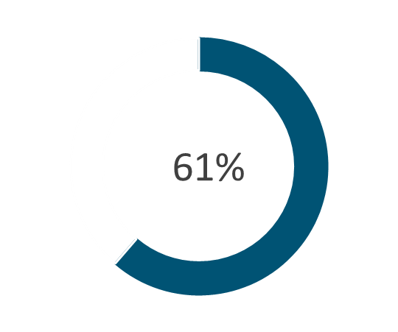
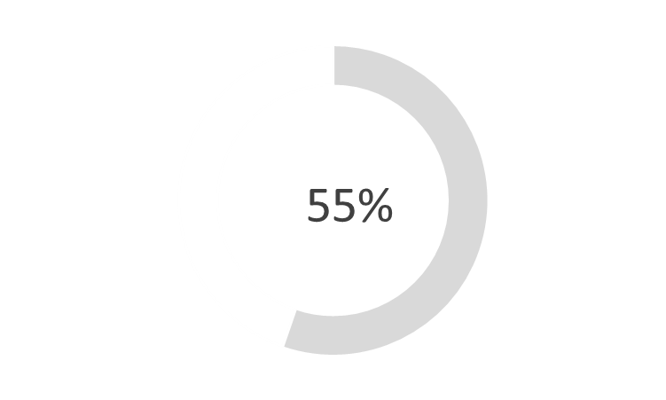
CAS Retention Outcomes
Fall 2016 to Spring 2017 Retention:
Among students referred by faculty who worked with a coach
Among students referred by faculty who declined coaching services

Slide 14
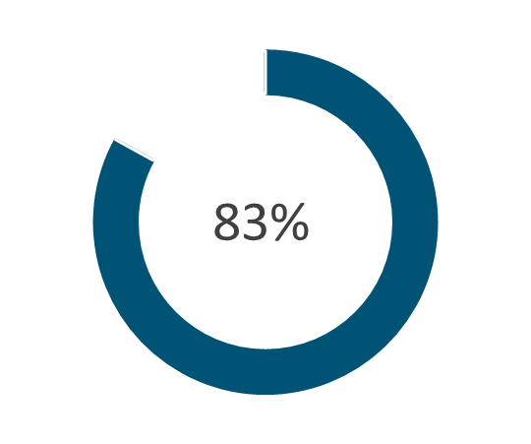
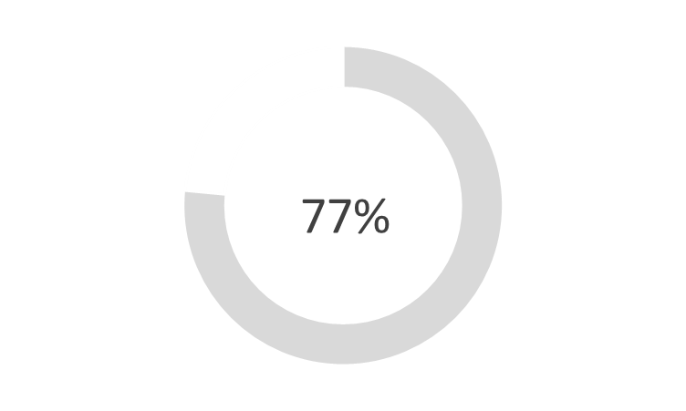
CAS Retention Outcomes
Fall 2016 to Spring 2017 Retention:
Among students who self-referred
Among students who were not referred and did not self-refer

Slide 15
Lessons Learned & Ideas to Use
Link coaches with faculty/course sections
Strive for one significant contact every four weeks
Change your approach to email
Commit to your role as a “cultural navigator”
Explain your early alert system to students
Start somewhere and keep going
Show hope to students

Slide 16
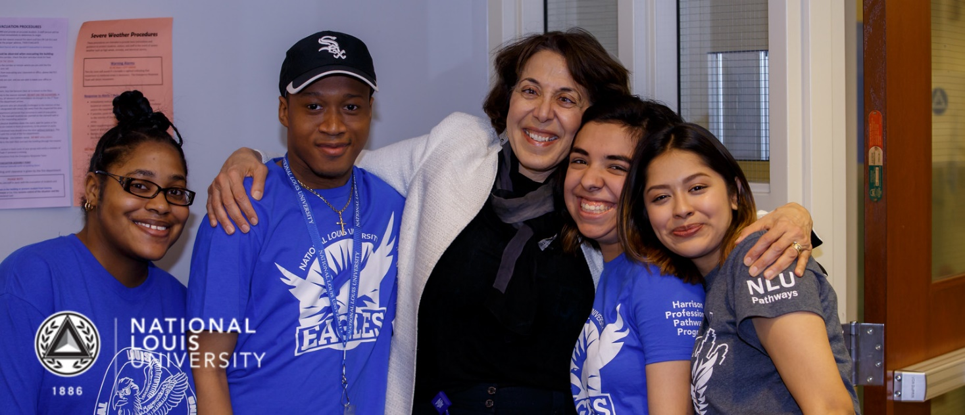
The new undergraduate model
Pathways at NLU
Notes:
From Nivine: I am delighted to announce the establishment of the Undergraduate College at NLU effective July 1st, 2018. The UGC enables us to realize our vision of a unified and best-in-class approach to undergraduate education at NLU, an approach that will propel the UGC to be a local and national leader in increasing undergraduate college access, completion, and employment, closing the opportunity gap in undergraduate student success. Driven by the uniquely affordable, rigorous, supportive, and professionally focused education we offer, the UGC will serve both Pathways (first-time, full-time, day-time freshman) and transfer students of all ages.

Slide 17
Who we serve: students at a glance
Notes:
The Freshman class has a 36% male population and 64% female. The Sophomore class has slightly higher male to female ratio, and the Junior class is over 75% female. The Wheeling Campus has about a 75% female to 25% male Freshman ratio, compared to about 60% Female to 40% male in Chicago.
The Freshman class has the highest percentage of Hispanic students. Looking only at the Chicago campus, 69.9% of Freshman students identify as Hispanic compared to 65.2% of Sophomore students.
Chicago – mostly CPS, charter
Wheeling – District 214, 211 and Waukegan

Slide 18
Students at a glance, continued
Notes:
There were no significant differences in Expected Family Contributions (EFC) between the Freshmen and Sophomore students.
EFC amounts varied between Chicago and Wheeling, with 85% Pell eligible students in Chicago vs. 69% in Wheeling. However, a greater percentage of Wheeling students (17.6%) identify as undocumented vs. Chicago (4.8%).
Note: 4 Freshmen and 2 Sophomore students did not have identified EFC and were excluded.

Slide 19
HS Academic profile for Freshmen
Campus | Avg. HS GPA | Avg. ACT Score
Chicago | 2.65 | 16.4
Wheeling | 2.85 | 18.1
All Freshman | 2.69 | 16.7
Notes:
4 Chicago students and 3 Wheeling students were missing HS GPAs and were excluded.
71 Chicago and 42 Wheeling students were missing ACT scores and were excluded.
Notes:
The majority of our students are coming from CPS and Chicago charter schools at the Chicago campus
Nearly 15% more students in Chicago have between a 2.0 and 2.5 than in Wheeling; additionally, a greater proportion of students in Wheeling had between a 3.0 – 3.49 GPA.
Although Chicago and Wheeling students have a small difference in HS GPA, Wheeling has a higher average ACT score by about 2 points and over 20% of students scoring 21+.

Slide 20
Fall 2017 to spring 2018 Retention
Freshmen retention was similar across campuses, with 80.9% in Wheeling, and 79.4% in Chicago.
Overall Sophomore retention was similar to Freshman retention, but slightly higher in Wheeling.
Juniors saw the highest retention rate at 84.1%.
Class | Chicago |  | Wheeling |  | All Students
 | # Retained | % Retained | # Retained | % Retained | # Retained | % Retained
Freshman | 340 / 428 | 79.4% | 89 / 110 | 80.9% | 429 / 538 | 79.7%
Sophomore | 158 / 201 | 78.6% | 23 / 27 | 85.2% | 181 / 228 | 79.4%
Junior | 37 / 44 | 84.1% | -- | -- | 37 / 44 | 84.1%
Total | 535 / 673 | 79.5% | 112 / 137 | 81.8% | 647 / 810 | 79.9%
Note: Includes students who were enrolled for Fall term, Winter term and also enrolled in Spring term as of 05/14/2018.
Notes:
Retention for the first two years of freshmen exceeded comparable benchmarks with its Year 1-2 retention average landing at 70% while serving a high-risk population. CPS graduates with a similar academic profile of Pathways students (based on ACT and GPA) tend to persist at 55%. This is a relevant benchmark because the vast majority of Pathways students in Chicago were CPS graduates.
Pathways at NLU has also seen strong demand, quadrupling enrollment in Year 2 and then doubling enrollment from Year 2 to 3. In its fourth year, we have over 4,500 applications year to date for a Fall 2018 start (vs. 3,600 at this time last year).

Slide 21
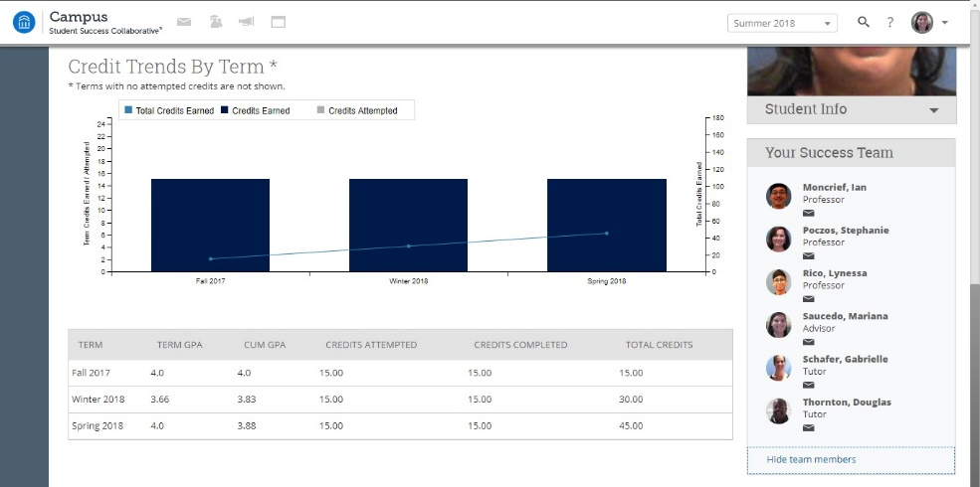
Design & Data Tracking
Courses at NLU
Students are in class 2 days a week, 4 classes for a full time schedule
The model is blended & flipped tailored to students’ various learning styles
EAB - Early Alert System
EAB allows us to assign cases, view coaching meeting reports, track attendance and see updated grades for all students
SSC meetings
Coaches and instructors meet weekly to check student progress, assign cases and keep up to date with students academic standing
Notes:
Student schedule: On campus 2 days a week, Study Tables available

Slide 22
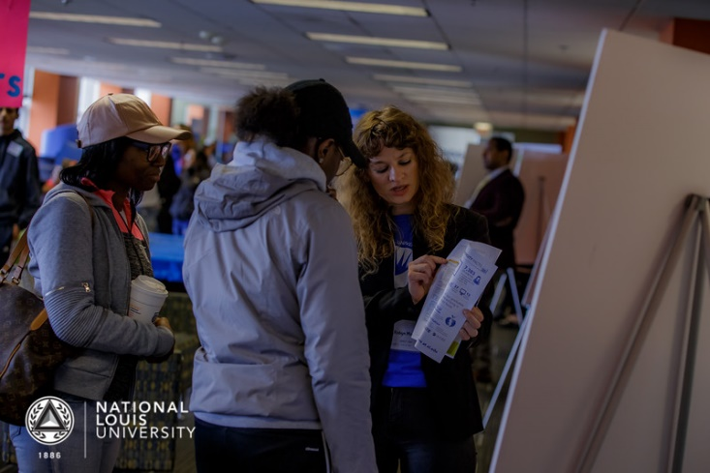
Personalized Instruction
NLU utilizes an adaptive online curriculum to meet students where they are
Face-to-face class time involves small class sizes, hands-on-projects, and discussions — no large lecture halls
Coaches are visible in Career Development Seminars and host interactive events for students to foster a sense of community

Slide 23
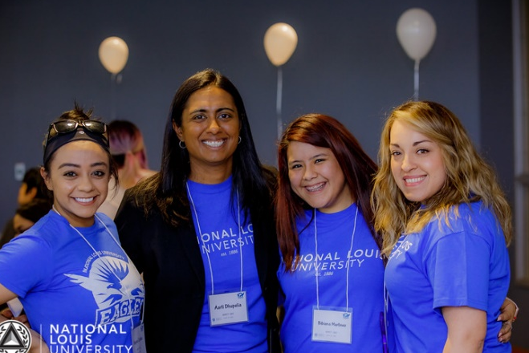
Coaching Model
Coaches provide intentional, wrap around social-emotional, academic, and career support to a cohort of 100 -130 students.
Coach Services
Summer melt
1-on-1s
High touch
Resources
Point-person
Notes:
“On average, coaches complete 90% or more of their required 1x1’s with students in the Fall and Winter/Spring quarters.”
Summer melt: Coaches communicate and meet with all their students the summer prior to starting class to reduce summer melt.
1-on-1s: During their freshmen year, 1-on-1’s happen once a quarter, a total of 3 times in a year. Students have 2 required 1-on-1s their sophomore year or more at their request.
High touch: Coaches, faculty, and academic support staff meet weekly to discuss student progress. Interventions are assigned based on need.
Resources: Often coaches refer students to additional resources such as counseling, social services, or academic tutoring.
Point-person: While we are not experts on everything NLU, we serve as a point-person for the students from the moment they commit to NLU and throughout their time at the university. We are able to point them in the right direction, and do follow-up.

Slide 24
Coaching Vision of Excellence
I am accessible, you are not a burden, I am here to support you.
I believe in you and will empower you to ensure you know/believe you are worth it and deserve the life you want.
I believe you not only deserve this opportunity, but you are capable and able to achieve.
I am authentic. I assume positive intent. I will not judge you, but rather meet you where you are and support you on your path.
I am invested in the whole picture. You will understand the logistical components of how you execute your plan. I know without it you are not truly in control to make your own decisions and choices that impact your life.
Notes:
Aarti, VP believes in the coaching model, intentional hiring and talent acquisition

Slide 25
Holistic Support
Understand and address students’ well-being needs to increase productivity and overall well-being.
Notes:
- Counseling services are also provided, as needed

Slide 26
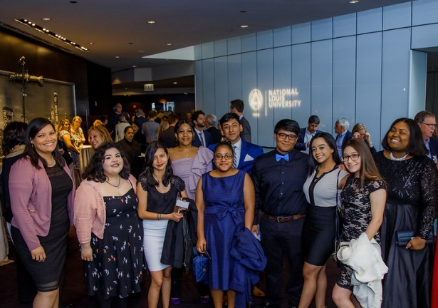
Student Advisory Council
Purpose: The Student Advisory Council will provide feedback and direction to the Vice President of Strategic Initiatives on central issues within UGC. Council members will develop their leadership and communication skills and meet with key decision makers to lead projects that turn recommendations into action.
Leadership: I aspire to use this opportunity to develop my own leadership and to model leadership in my college community.
Voice: I commit to serving as the representative of my cohort by collecting meaningful feedback from classmates.
Impact: I recognize that I am an essential part of the Pathways program, providing tangible recommendations that drive improvements and create real change.
Notes:
Aarti, VP, co-facilitates the SAC. Students meet once a month to address challenges and meet with leadership from all different depts. (Admin, Career, Enrollment) allowing students to develop their leadership skills and have a place in changes happening at NLU. This is a great example of how leadership is engaged at various levels of Pathways.
Example: “The Den” Student Center at the Chicago campus – students wanted a space to hang out with friends so the campus flipped the library space to create the Den.
Photos:
Left – Reach Gala, students attended and met with alumni, staff, admin, and funders. Asia spoke on her transition from HS to NLU and how she grew into her leadership roles.
Right – SAC members hosted a Leadership Café to meet with Admin, researching how to create new opportunities for students.

Slide 27
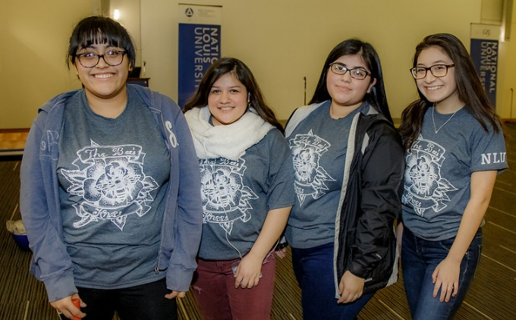
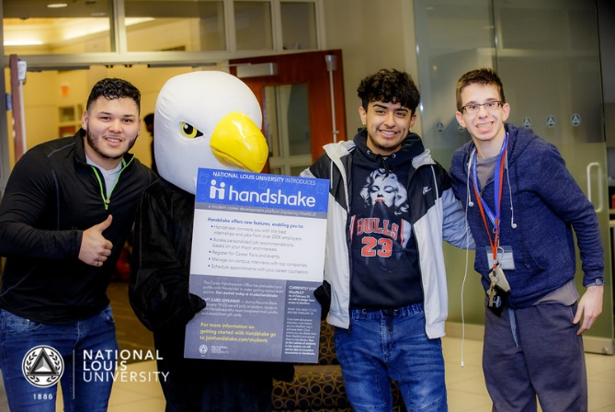
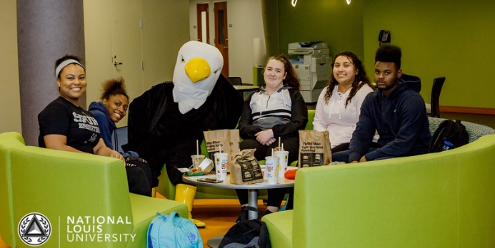
Cohort Identity
Opportunities for students to engage with each other outside of class to help foster community and connectedness.
Team names and logos
Weekly study tables
Quarterly talking circles
Social events

Slide 28
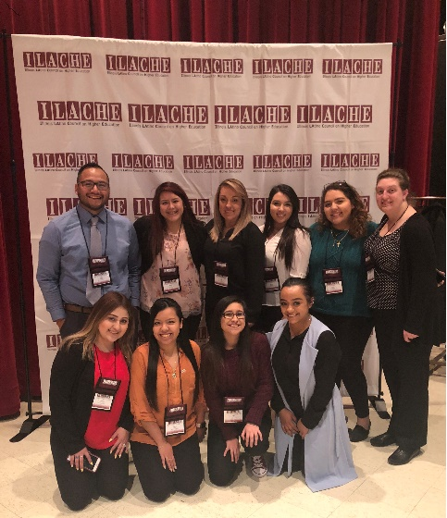
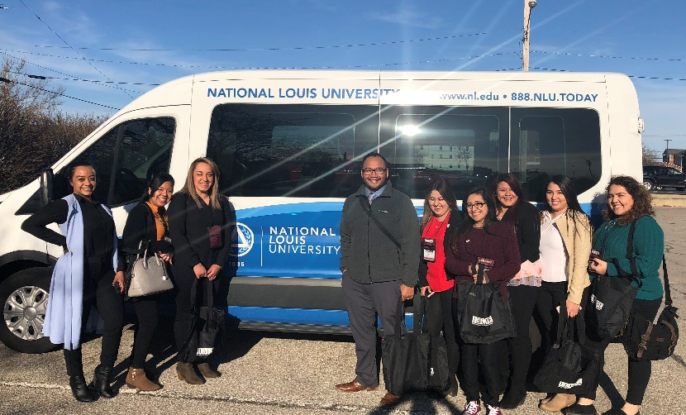
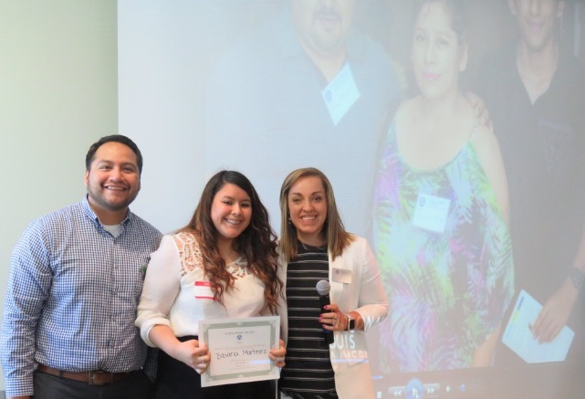
Wheeling Campus Initiatives
Student Engagement Club
Educators Rising Club
FIG FACTOR Foundation: Empowering Latina Students
Latino Family Conference
Notes:
Creating the soccer field in partnership with Wheeling Park District.
We have been able to assess student needs at both campuses, tailoring our services to meet the needs of our diverse student body.

Slide 29
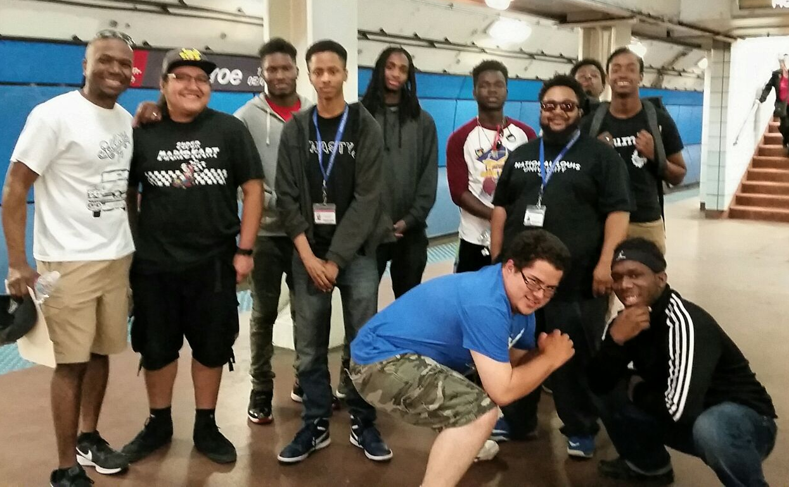
Future initiatives: What’s next?
Braven Career Accelerator
Eagle Brotherhood (revamped male initiative launching Fall ‘18)
Handshake platform
Guide – EAB app

Slide 30
Thank You
Pathways at
National Louis University
Mariana Saucedo,
Student Success Coach
312-261-3602
msaucedo3@nl.edu
Lady Gil, Student Success Coach
847-947-5080
lgil@nl.edu
www.nl.edu/academics/pathwaysatnlu
Coaching for Academic Success at College of Lake County
Eric Tammes,
Director of Academic Success
847-543-2763
etammes@clcillinois.edu
www.clcillinois.edu/cas

